Slide 1
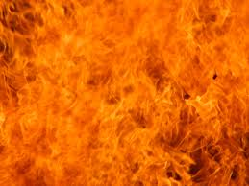
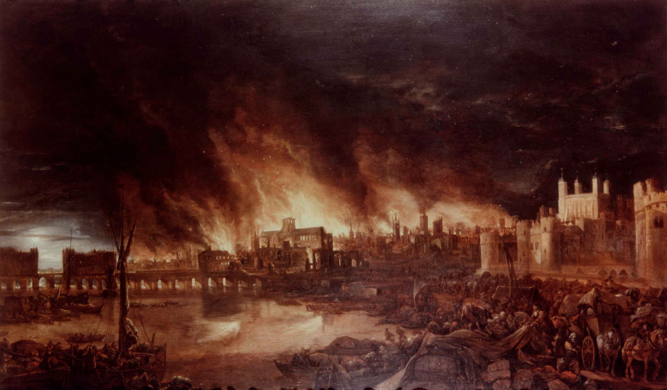
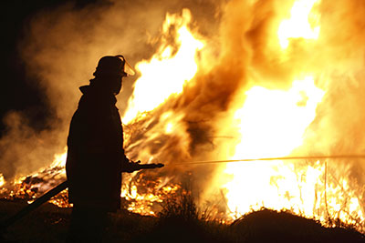
English
We will be learning how to form our pre-cursive letters correctly as well as remembering to use capital letters, finger spaces and full stops consistently. We will be looking at a number of familiar stories including The Three Little Pigs and The Three Billy Goats Gruff. We will also be using non-fiction texts to support us writing pieces for an in-class art exhibition. We will be drawing on what we have learnt about The Great Fire to create our own poems.
Our topic is
Fire Fire!
Mathematics
We will explore number and place value – working on recognising, ordering and using numbers to 100 and beyond. We will learning to measure length, capacity and weight.
We will also learn to tell the time to the hour and half past the hour. The children will explore and learn to identify different fractions. We will name and recognise coins and notes. We will look at different 2D and 3D shapes and discuss their properties. Every week we will be putting into practice the skills we have learnt by completing lessons in problem solving.
Phonics
The children will be assessed and taught in differentiated groups depending on which phase they are in.
History
This term we are going to learn about The Great Fire of London. We will be able to locate London on a map of the United Kingdom and discuss the events that led to the fire. We will also think about why the fire spread so quickly and talk about the differences between fire fighters then and now.
Science
In Science we are going to be learning about the 4 seasons. We will also be exploring different objects and which materials they are made from.
Physical Education
This term we will be completing some dance sessions about The Great Fire of London. We will work on running, jumping, team games and ball games.
Art and Design
We will be using a variety of media to create silhouettes of buildings and portraits of the Great Fire. We will be using wood to make a Tudor house and recreate Pudding Lane. We will be baking some traditional Christmas cakes. We will also be learning how to sew by sewing our own Christmas stockings
Geography
We will learn to name and locate the four countries and capital cities of the United Kingdom as well as the seas surrounding us. We will also study the grounds of our school.
PSHCE
In PSHCE we will be learning about diversity and learning about how we are unique and wonderful and different to every other person on the planet. We will also be learning about how to stay healthy and safe.
Computing
We will start by using tablets to learn how to input algorithms and use coding programs. We will also learn basic skills on our desktop computers in our Learning Resource Centre.
Religious Education
This term we will begin by looking at our places and people which are special to us. Then we will discuss special times in our lives.
Music
We will continue to sing and enjoy learning about different musicians. We will focus on London’s Burning and later on our Christmas show songs.

